Slide 1
Review Concurrency Control
chapter 13: “Concurrency Control” (Petkovic)
ACID Property: https://en.wikipedia.org/wiki/ACID_(computer_science)
Concurrency control https://en.wikipedia.org/wiki/Concurrency_control

Slide 2
Concurrency Control
If concurrent transactions with interleaving operations are allowed in an uncontrolled manner such as:
The lost update problem
The dirty read problem
Non-repeatable read
Phantom read
Notes:
Many transactions in a database performing different operations at the same tme. Without control we can have these 4 problems

Slide 3
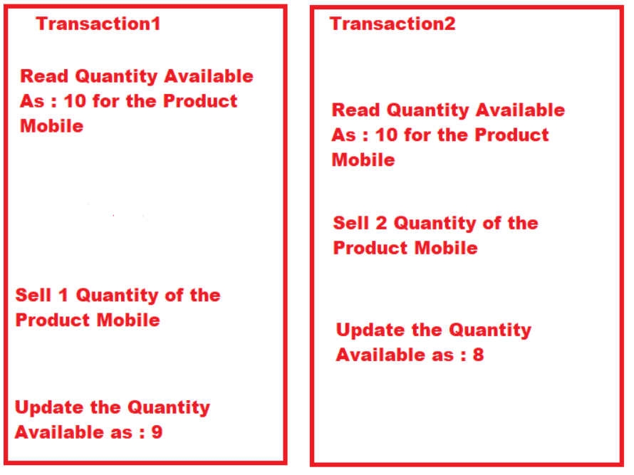
Lost Update Problem
https://dotnettutorials.net/lesson/sql-server-lost-update-concurrency-problem/
Notes:
Two transactions running at the same time.
A -> sees quantity as 10, sells one then updae the quantity to 9
B- sees quatntity as 10, sells two units then updates to 8
What is the final number of quantity as it is drawn in the diagram

Slide 4
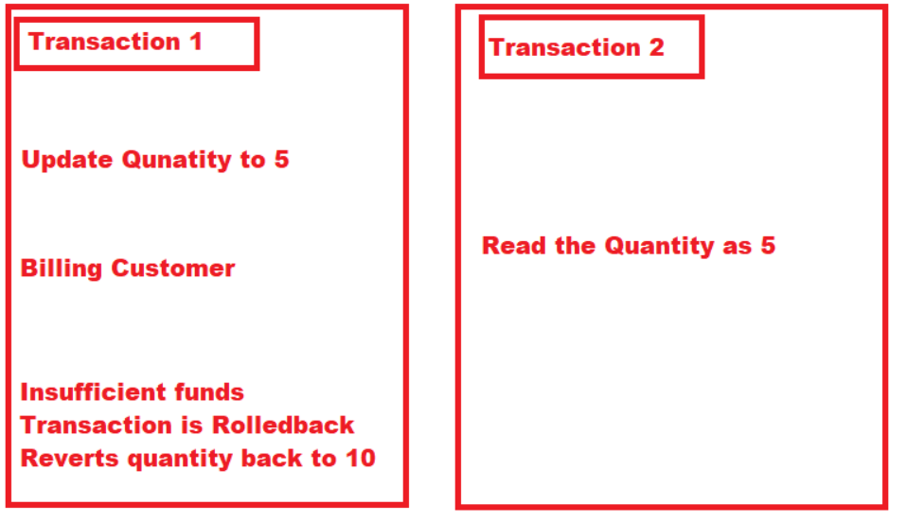
Dirty Reads Problem
https://dotnettutorials.net/lesson/dirty-read-concurrency-problem-sql-server/
Notes:
Dirty reads – reading values that do not exist. Or values that are not committed.

Slide 5
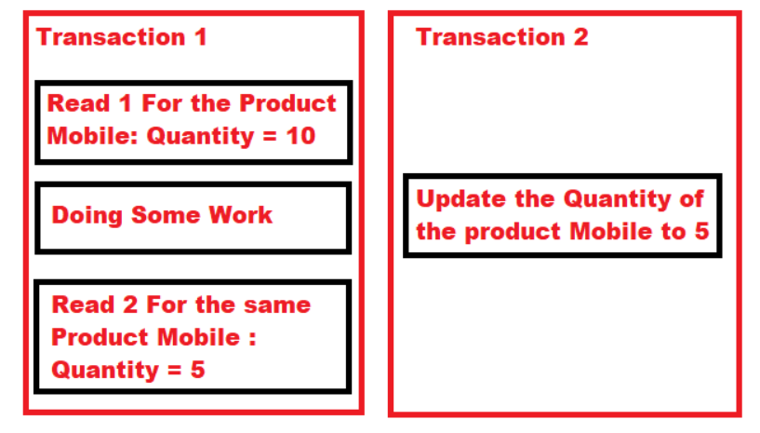
Non-Repeatable Read Problem
https://dotnettutorials.net/lesson/non-repeatable-read-concurrency-problem/
Notes:
If reading the same records twice should always produce the same records.
This example it is not

Slide 6
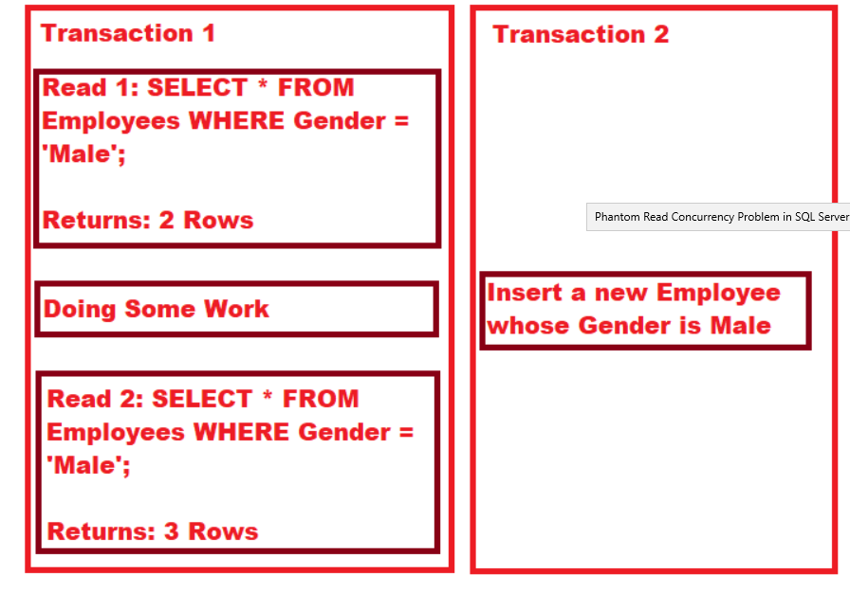
Phantom read problem
https://dotnettutorials.net/lesson/phantom-read-concurrency-problem-sql-server/
Notes:
Same as before except the number of records go up

Slide 7
Concurrency control mechanisms
Optimistic - Delay the checking of whether a transaction meets the isolation and other integrity rules (e.g., serializability and recoverability) until its end, without blocking any of its (read, write)
Pessimistic - Block an operation of a transaction, if it may cause violation of the rules, until the possibility of violation disappears. Blocking operations is typically involved with performance reduction.
Semi-optimistic - Block operations in some situations, if they may cause violation of some rules, and do not block in other situations while delaying rules checking (if needed) to transaction's end, as done with optimistic.
Notes:
Optimistic concurrency works on the assumption that a transaction is
unlikely to modify data that another transaction is modifying at the same
time.
Pessimistic concurrency assumes that a conflict between two or more
processes can occur at any time and therefore locks resources (row, page,
table), as they are required, for the duration of a transaction

Slide 8
Transactions
Transaction = A discrete unit of work that must be completely processed or not processed at all
May involve multiple updates
If any update fails, then all other updates must be cancelled
Packages together read and write operations so that the database system can guarantee the consistency of data
Transaction Types:
Implicit -> Specifies any single INSERT, UPDATE, or DELETE
statement as a transaction unit
Explicit ->marked using statements
such as BEGIN TRANSACTION, COMMIT, and ROLLBACK

Slide 9
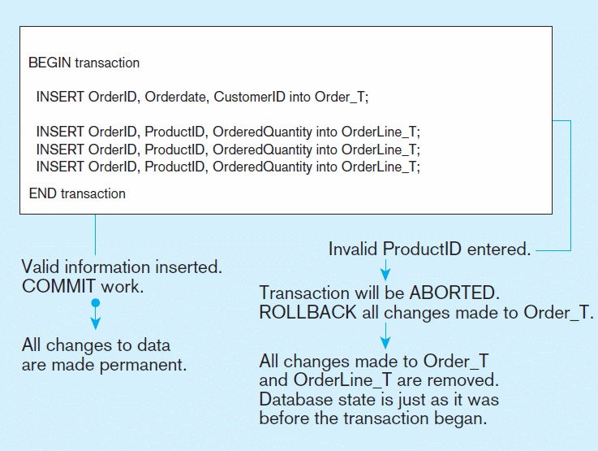
Figure 7-10 An SQL Transaction sequence (in pseudocode)

Slide 10
COMMIT EXAMPLE
BEGIN transaction t1
INSERT INTO department values ('D6' , 'Marketing', 'San Francisco' )
INSERT INTO department values ('D7' , 'Customer Serv', 'Chicago' )
SELECT * FROM department
ORDER BY dept_no
COMMIT;
SELECT *
FROM department

Slide 11
Rollback Example
BEGIN transaction t1
INSERT INTO department values ('D6' , 'Marketing', 'San Francisco' )
INSERT INTO department values ('D7' , 'Customer Serv', 'Chicago' )
SELECT * FROM department
ORDER BY dept_no
ROLLBACK;
SELECT *
FROM department

Slide 12
Properties of Transactions
ACID Properties:
Atomicity
Consistency
Isolation
Durability
set of properties of database transactions intended to guarantee validity even in the even in the event of errors
a sequence of database operations that satisfies the ACID properties (and these can be perceived as a single logical operation on the data) is called a transaction.)
Notes:
The goal of ACID properties to guarantee the data integrity and validity when failures occurs.
What kind of failures: power outages, network outages, errors resulting from a dived by zero operation.
The ACID property is satisfied by what is called a TRANSACTION –single logical operation of the data.

Slide 13
Atomicity
Atomicity guarantees that each transaction is treated as a single "unit", which either succeeds completely, or fails completely
if any of the statements constituting a transaction fails to complete, the entire transaction fails and the database is left unchanged.
An atomic system must guarantee atomicity in each and every situation, including power failures, errors and crashes.
Notes:
Each transaction is treated as a single unit.
It either completes or fails
This means that either all data modifications in a transaction are executed
or, in the case of any failure, all already executed changes are undone.

Slide 14
Consistency
Any data written to the database must be valid according to all defined rules, including constraints, cascades, triggers, and any combination thereof.
This prevents database corruption by an illegal transaction, but does not guarantee that a transaction is correct.
Notes:
All of the rules defined in the database must be valid.
NOT NULL, CONSTRAINTS ( CHECK, FK,PRIMARY KEY,UNIQUE)
CASCADE rules,
TRIGGERS
the transactional transformations
on data bring the database from one consistent state to another.

Slide 15
Isolation
Transactions are often executed concurrently (e.g., reading and writing to multiple tables at the same time).
Isolation ensures that concurrent execution of transactions leaves the database in the same state that would have been obtained if the transactions were executed sequentially
Notes:
Two issues there:
Two transactions trying to update the data at the same time. An update and a read at the same time.
an active transaction can’t see data modifications in
a concurrent and incomplete transaction. This means that some
transactions might be rolled back to guarantee isolation.
I will cover different types of ISOLATION levels

Slide 16
Durability
Durability guarantees that once a transaction has been committed, it will remain committed even in the case of a system failure (e.g., power outage or crash).
This usually means that completed transactions (or their effects) are recorded in non-volatile memory.
Notes:
For this reason, if a system error occurs while a transaction is active, all statements of that
transaction will be undone.

Slide 17
Transaction Log
Track each change made to the database during a transaction
Each database has its own transaction log
Transaction Logs are created as files in the database
Notes:
Transaction log is necessary in case an error occurs during the execution of the transaction.

Slide 18
Types of data stored in transaction logs
Before Images – if an error occurs, system rolls back all modifications since the start of the transaction. The process is called undo activity .
After Images - used to roll forward all modifications since the start of the transaction. The process is called redo activity
Write Ahead Log - In case of system failure, transactions not committed needs to be persisted. The task of write-ahead logging is to provide high availability and consistency in case of failure

Slide 19
Locking
To prevent problems in the pessimistic concurrency model, every DBMS must have mechanisms that control the access of data by all users at the same time.
Locking has several different aspects:
Lock duration
Lock modes
Lock granularity
Notes:
Concurrency can lead to several negative effects, such as the reading of nonexistent data or loss of modified data. Consider this real-world
example illustrating one of these.
Dirty reads: provide an example of address change.
Lock duration ( how long to hold the lock for, depends on isolation levels)
Lock modes ( what type of lock is being set exclusive, shared)
Lock granularity ( on a row, a page, a table, or a db)

Slide 20
Lock modes (row and page level)
Shared - reserves resources for reading only
Exclusive - reserves resources for the exclusive use of a single transaction
Update - An update lock can be placed only if no other update or exclusive lock exists. It can be placed on objects that already have shared locks.
Notes:
Shared - reserves resources for reading only. Other processes cannot modify it. Several processes can read the resource locked with
the shared lock.
Exclusive -> It is used for DML statements (INSERT, UPDATE, and DELETE) that modify the resource
Update. After Shared locks are gone, it is upgraded to exclusive

Slide 21
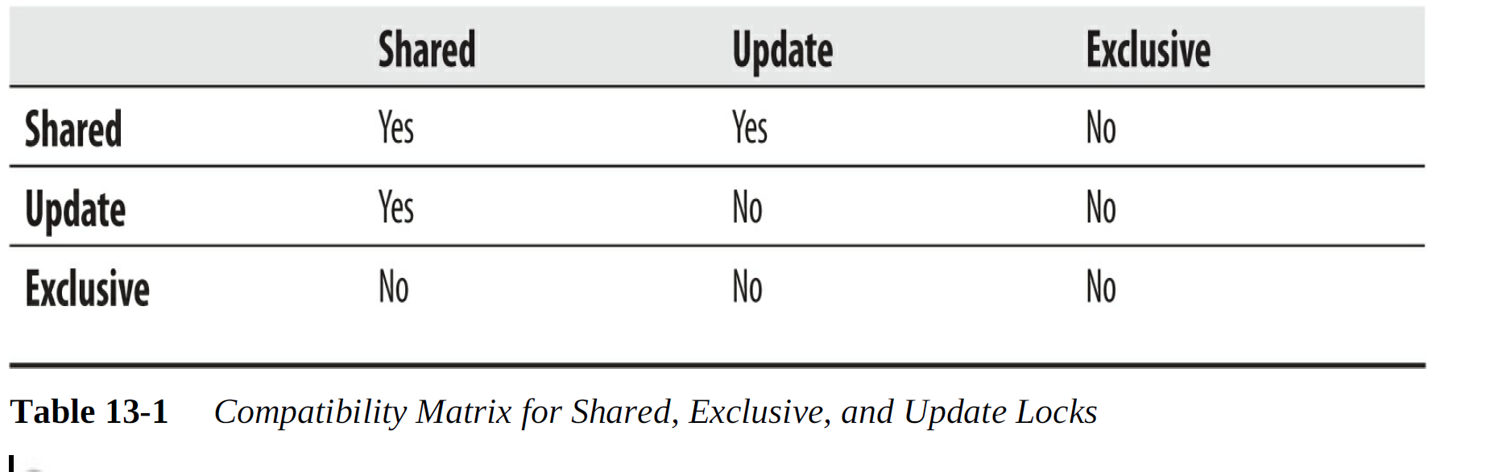
Compatibly Matrix for Locks

Slide 22
Lock Granularity
Row
Page
Index key or range of index keys
Table
Extent
Database itself
Notes:
Index key or range of index keys – for a clustered table, with cluster index the data pages are stored at the leaf level of the
(clustered) index structure and are therefore locked with index key locks
instead of row locks.
Locking is also done on disk units, called extents, that are 64K in size
(see

Slide 23
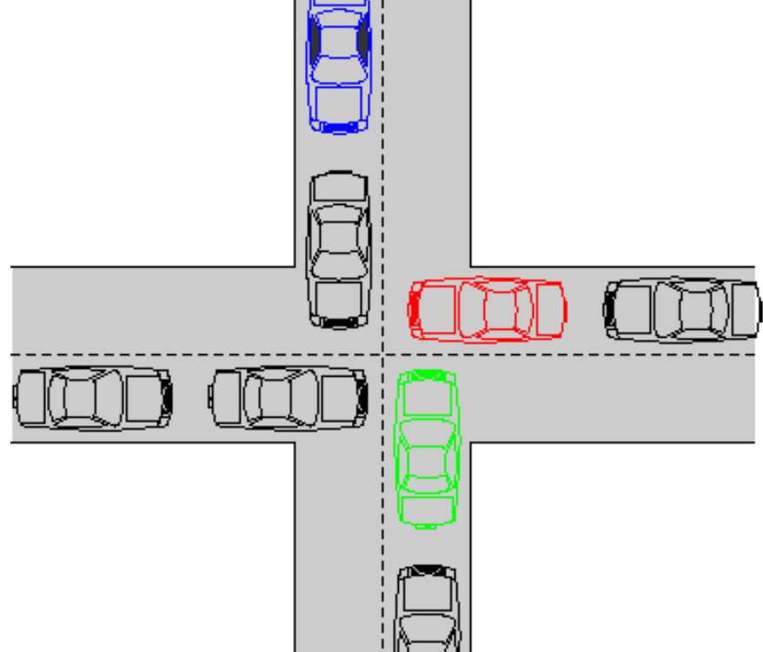
Deadlock
two transactions block the progress of each other
The first transaction has a lock on some database object that the other transaction wants to access, and vice versa.

Slide 24
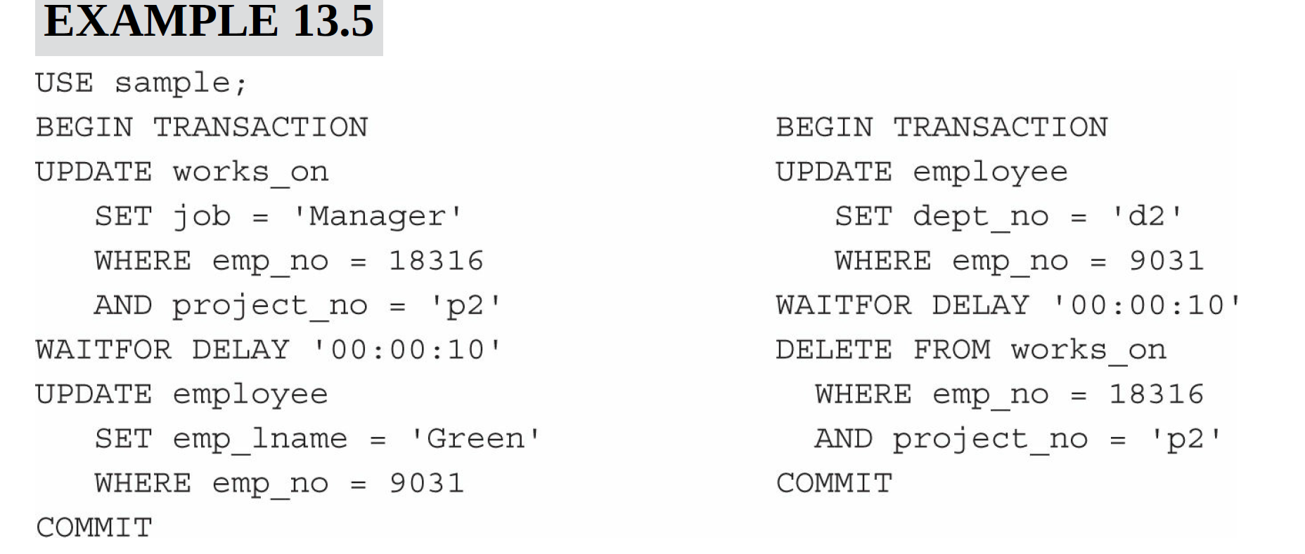


Slide 25
Concurrency Problems
Lost update
Dirty reads
Nonrepeatable reads
Phantoms
Notes:
The lost update concurrency problem occurs when no isolation is provided to a transaction from other transactions. This means that several transactions can read the same data and modify it. The changes to the data by all transactions, except those by the last transaction, are lost.
Dirty reads - reading process can see data that doesn’t exist
The nonrepeatable read concurrency problem occurs when one process reads data several times, and another process changes the same data
between two read operations of the first process. Therefore, the values read by both read operations of the first process are different.
The phantom concurrency problem is similar to the nonrepeatable read concurrency problem, because two subsequent read operations can display different values, but in this case, the reason for this behavior lies in the different number of rows being read the first time and the second time. (Additional rows, called phantoms, are inserted by other transactions.)

Slide 26
Isolation Levels
Pessimistic model
READ UNCOMMITTED
REPEATABLE READ
SERIALIZABLE
Optimistic model
SNAPSHOT
Both models
READ COMMITTED
Notes:
Using isolation levels, you can specify which of the concurrency problems discussed in the preceding section may occur and which you want to avoid.

Slide 27
READ UNCOMMITTED
Does not isolate the read operations from other transactions at all.
It acquires no locks and respects none of the existing locks
The data is read may be inconsistent. If the latter transaction rolls back later, the former transaction reads data that never really existed.
Notes:
the four concurrency problems described in the preceding section,
READ UNCOMMITTED allows dirty reads, nonrepeatable reads, and
phantoms.
The weakest ISOLATION LEVEL? So why use it?
Reduced potential locks, and deadlocks
Increase performance , doesn’t have to lock
Risks -> reading inconsistent data, phantom records etc
One needs to carefully analyze your database before making this choice.

Slide 28
READ COMMITTED
Tests only whether an exclusive lock is placed on the row. If no such lock exists, the transaction fetches the row.
This is done using a shared lock. After reading the data values, the data can be changed by some other transaction.
Prevents the transaction from reading data that is not committed
Concurrent data is improved, but nonrepeatable reads and phantoms can still happen.
Notes:
This action prevents the transaction from reading data that is not committed and that can be subsequently rolled back.
access to the concurrent data is improved, but nonrepeatable reads and phantoms can still happen.
The READ COMMITTED isolation level is the default isolation level for SQL Server Database Engine

Slide 29
REPEATABLE READ
places shared locks on all data that is read and holds these locks until the transaction is committed or rolled back.
The disadvantage of this isolation level is that concurrency is further reduced, because the time interval during which other transactions cannot update the same data is significantly longer than in the case of READ COMMITTED.
does not prevent another transaction from inserting new rows, which are included in subsequent reads, so phantoms can appear.
Notes:
Draw a picture
Showing for the whole transaction how it locks the rows

Slide 30
SERIALIZABLE
acquires a range lock on all data that is read by the corresponding transaction
also prevents the insertion of new rows by another transaction until the former transaction is committed or rolled back
SERIALIZABLE is the strongest isolation level
Notes:
The SERIALIZABLE isolation level is implemented using a key-range
locking method. This method locks individual rows and the ranges
between them.

Slide 31
Setting and Editing Isolation Levels
The TRANSACTION ISOLATION LEVEL clause of the SET statement
Isolation-level hints
READUNCOMMITTED
READCOMMITTED
REPEATABLEREAD
SERIALIZABLE
Notes:
SET TRANSACTION ISOLATION LEVEL READ UNCOMMITTED

Slide 32
Row Versioning
When data is modified using row versioning, logical copies of the data are maintained for all data modifications performed in the database
DB Engine stores the before image of the previously committed row in tempdb (SQL Server), TEMP tablespace (Oracle)
Each version is marked with a version number
Row versioning isolates transactions from modifications without requesting share locks on rows that have been read.
Notes:
Row versioning isolates transactions from the effects of modifications made by other transactions without the need for requesting shared locks on
rows that have been read.

Slide 33
Row versioning Isolation models
Read Committed Snapshot Isolation (RCSI) -> read operations do not block updates, and updates do not block read operations.
Snapshot Isolation (SI) ->any other transaction will read the committed values as they exist just before the snapshot transaction starts.
Notes:
The most important difference between the two forms of row versioning is hat SI can result in update conflicts when a process sees the same data for the duration of its transaction and is not blocked.

Slide 34
Locking vs multi-versioning
Locking means that the transaction marks the data that it accesses so that the DBMS knows not to allow other transactions to modify it until the first transaction succeeds or fails.
database provides each reading transaction the prior, unmodified version of data that is being modified by another active transaction. This allows readers to operate without acquiring locks, i.e., writing transactions do not block reading transactions, and readers do not block writers.

Slide 35
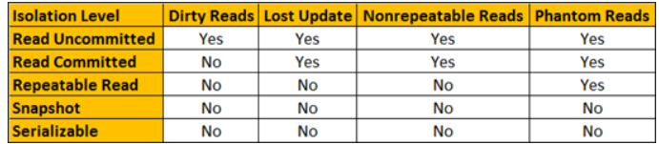
Summary of Isolation Levels
http://csharp-video-tutorials.blogspot.com/2015/08/sql-server-lost-update-problem.html

Slide 36
Distributed transactions
the two-phase commit protocol (not to be confused with two-phase locking) provides atomicity for distributed transactions to ensure that each participant in the transaction agrees on whether the transaction should be committed or not
Briefly, in the first phase, one node (the coordinator) interrogates the other nodes (the participants) and only when all reply that they are prepared does the coordinator, in the second phase, formalize the transaction.

